Slide 1

Photo-Realistic Single Image Super-Resolution Using a Generative Adversarial Network
Prepared By:
Saurabh Kumar Chauhan

Slide 2
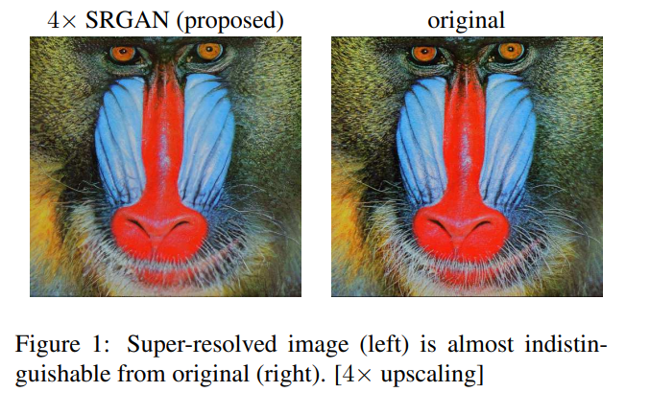
Paper
Implementation is mostly derived from the paper
http://openaccess.thecvf.com/content_cvpr_2017/papers/Ledig_Photo-Realistic_Single_Image_CVPR_2017_paper.pdf
written by
Christian Ledig, Lucas Theis, Ferenc Husz´ar, Jose Caballero, Andrew Cunningham, Alejandro Acosta, Andrew Aitken, Alykhan Tejani, Johannes Totz, Zehan Wang, Wenzhe Shi

Slide 3
Problem Statement
how do we recover the finer texture details when we super-resolve at large upscaling factors?
The behavior of optimization-based super-resolution methods is principally driven by the choice of the objective function. Recent work has largely focused on minimizing the mean squared reconstruction error. The resulting estimates have high peak signal-to-noise ratios, but they are often lacking high-frequency details and are perceptually unsatisfying in the sense that they fail to match the fidelity expected at the higher resolution.

Slide 4
Implementation
Models:
Gan (General Adversarial Networks)
Loss Function:
Adversarial Loss: Uses Binary Cross Entropy between target labels and generated labels by Discriminator
Content Loss: Uses Mean Square error between the features extracted from generated Super resolution image and original HD image by pre trained vgg19 model
Evaluation Matrix: (Between generated image and original Image)
SSIM (structure similarity Index)
PSNR (peak signal to noise ratio)

Slide 5
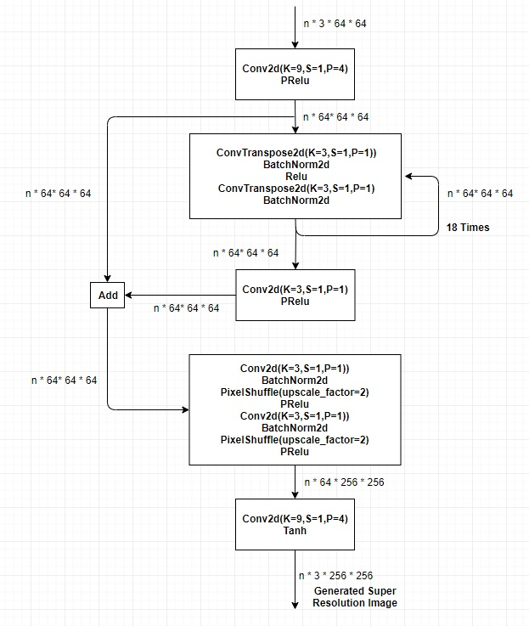
Model(GAN)
Generator:
consist of 5 layers
Accept image with 3 channels
and of size 64 * 64
Produces a super resolution
Image of size 3 * 256 * 256
Second layer received its out
as a feedback 18 times before
forwarding to next layer

Slide 6
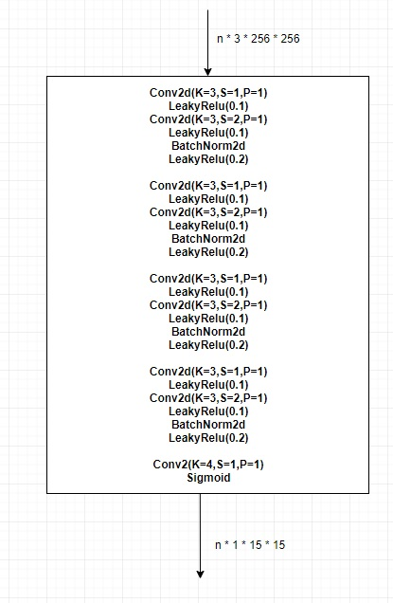
Model(GAN)
Discriminator
Consist of single sequential layer with
multiple inner convolutions
Receive Image of size 3 * 256 * 256
Produce Sigmoid output of size 1 * 15 *15
Where 15 * 15 is the feature map of values
ranging between 0 and 1

Slide 7
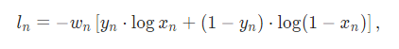
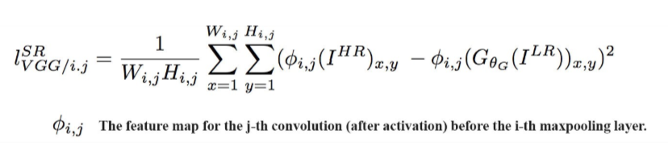
Loss Functions
Adversarial Loss:
Uses Binary Cross Entropy between target labels and generated labels by Discriminator (nn.BCELoss)
Content Loss:
We can compute the content loss pixel-wise using mean square error, but it calculate distance mathematically but in SRGAN we try to use perceptual loss measuring the MSE of features extracted by a VGG-19 network.(layer 19 of vgg network in current implementation)

Slide 8
Generator vs Discriminator Loss Function
Generator loss function:
gen_loss = content_loss + adverasial_loss
where
content_loss = MSE of HR and SR feature values extracted by vgg19 model
adverasial_loss = BCE of true target values to values produced by discriminator for the generated image of generator
Discriminator loss function
des_loss = adverasial_loss(HR) + adverasial_loss(SR)
where
adverasial_loss(HR) = BCE of true target values to values produced by discriminator for the Real HR images adverasial_loss(SR) = BCE of true target values to values produced by discriminator for the generated image of generator

Slide 9
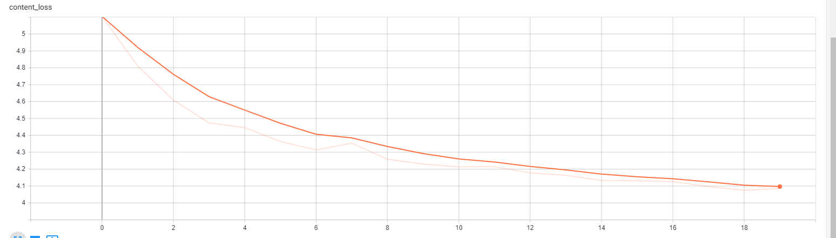
Graphs
Content Loss:
MSE between SR and HR Image’s feature
extracted from trained vgg19 model.
It provides better baseline to validate if the
generator is improving or not
As the MSE continuously dropping signifies
model is improving

Slide 10
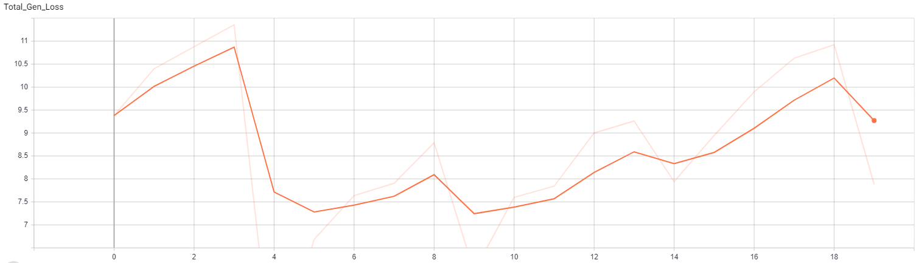
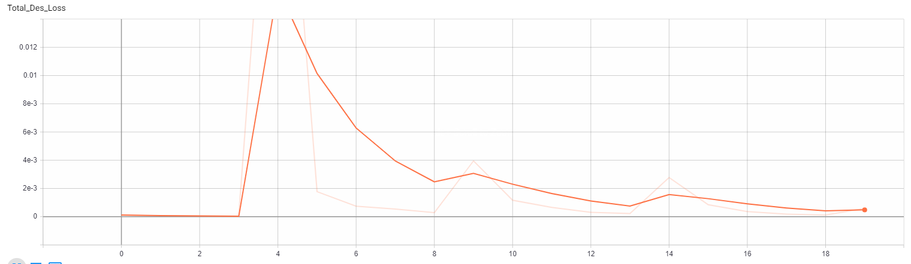
Graph:
Generator loss(total):
Discriminator loss(total):

Slide 11
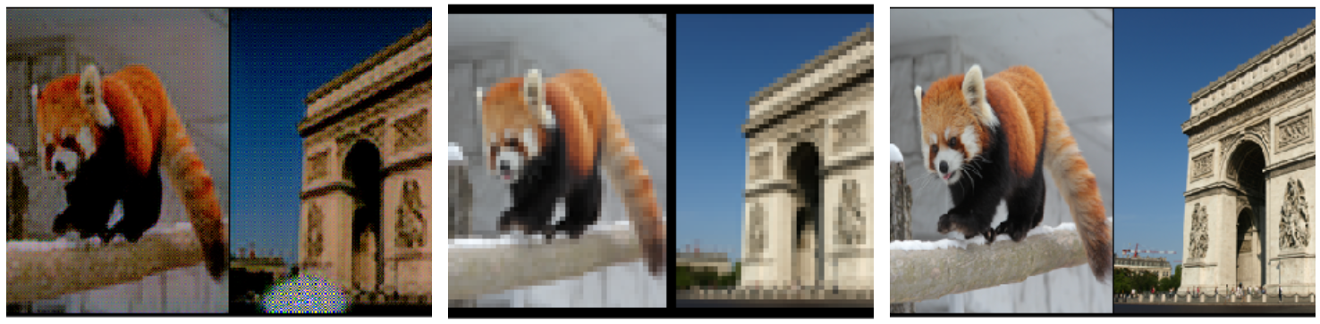
Image Comparison
Left Image: Generated Image by generator
Middle Image: Low resolution Image(Generator input)
Right Image: HR image (high resolution)

Slide 12
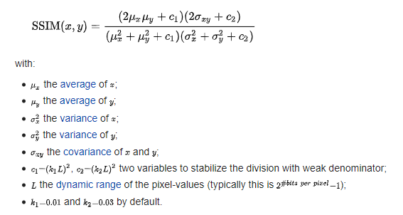
Evaluation Matrices
SSIM (Structure similarity Index)
One of the comparison mechanism to compute similarity between two image, use to find SSIM between original HR image and generated SR image. It is a method for predicting the perceived quality of image and then to find the similarity between both images.
: https://en.wikipedia.org/wiki/Structural_similarity
image source

Slide 13
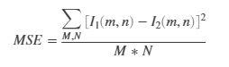
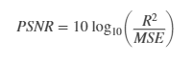
Evaluation Matrices
PSNR: (peak signal to noise ratio)
This ratio is used as a quality measurement between the original and a compressed image. The higher the PSNR, the better the quality of the compressed, or reconstructed image.
image source: https://www.mathworks.com/help/vision/ref/psnr.html
First Calculate the mean square error between both image’s pixel values using MSE formula
where M * N are image size
Then calculate the PSNR value using below formula
Where R is the maximum fluctuation in the input data which is 255 in our case.

Slide 14
Evaluation comparison on BSD100
Performance of different model in term of image quality of the generated images
Implemented SRGAN performance was low due to training time was just 4 days, but still SSIM is quite good and will improve if we increase the depth of our generator and more training time.
 | SRCNN | SelfExSR | DRCN | ESPCN | SRResNet | SRGAN
PSNR | 26.68 | 26.83 | 27.21 | 27.02 | 27.58 | 12.24
SSIM | 0.7291 | 0.7387 | 0.7493 | 0.7442 | 0.7620 | 0.6272

Slide 15
References:
https://www.slideshare.net/WoojinJeong5/review-srgan (slide 11)
http://openaccess.thecvf.com/content_cvpr_2017/papers/Ledig_Photo-Realistic_Single_Image_CVPR_2017_paper.pdf (paper)
https://github.com/eriklindernoren/PyTorch-GAN/blob/master/implementations/srgan/models.py
https://medium.com/@jonathan_hui/gan-super-resolution-gan-srgan-b471da7270ec
https://medium.com/analytics-vidhya/super-resolution-gan-srgan-5e10438aec0c

